Slide 1

Fraud Analysis:
Unveiling Fraudulent Behaviour and Uncovering Patterns in Bank Accounts through Data Analysis

Slide 2
Member Info
Submitted To:
Khan Md. Hasib
Assistant Professor
Department of Computer Science and Engineering (CSE)
Submitted By:
Nahida Fatme (19202103127)
Md. Moynul Islam (19202103141)
Jahid Farhad Apon (19202103147)
Md. Mahmudur Rahman (19202103379)
Supervisor:
Md Rakib Hossen (19202103289)
Md. Masudul Islam
Assistant Professor
Department of Computer Science and Engineering (CSE)

Slide 3
Table of Content
1. Introduction
2. Motivation
3. Objective
4. Literature Review
5. Critical Challenges
6. Methodology

Slide 4




01
Introduction
In today's technologically driven world, businesses and financial institutions face an ever-growing challenge fraud. Fraudulent activities can cause substantial financial losses, damage reputations, and undermine trust in critical systems.
The Fraud Analysis and Detection is an advanced and comprehensive system designed to identify, analyze, and find fraudulent behaviors and transactions.
By leveraging cutting-edge technologies, data analysis, and machine learning algorithms
Aim is to provide organizations with robust tools to detect suspicious activities in real-time, minimize losses, and enhance overall security.
Page 01

Slide 5



02
Motivation
data analysis can provide a more comprehensive solution then traditional rule-based technique and manual investigations
The insights gained from data analysis can aid in the development of proactive fraud prevention measures, enabling banks to minimize financial losses
Detecting fraud in bank accounts through the training of machine learning models offers several compelling benefits for financial institutions
Page 02

Slide 6
03
Objective
1
2
3
4
Review and analyse the current approaches in banking fraud
Collect and compile a high-quality dataset of bank accounts
Detect Fraud and compare accuracy among different models
to find hidden patterns and identify suspicious behaviours
5
6
7
8
Find out detection accuracy, precision, recall, false positive rates and false negative.
Examine the dataset for developing fraud trends and modify the models accordingly
Extract meaningful insights and create visualization
summarize the findings, highlight the novel contributions
Page 03

Slide 7
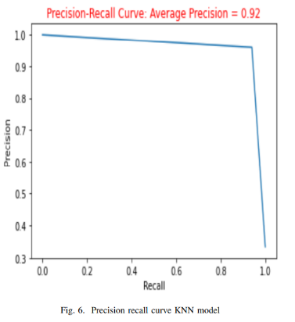
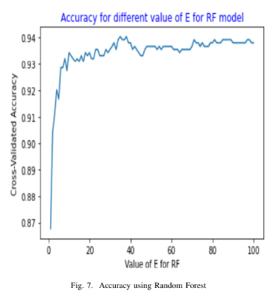
04
Literature Review
Data Analysis for Fraud Detection in Finance:
Almutairi et al proposed methodology to give insights and strategies for institutions, notably banks, to preserve user information and secure their systems against fraudsters by presenting a conceptual framework based on a real-world credit card dataset.
Their results are: K-Nearest Neighbor (KNN) 96.7%, Random Forest 94%, and XGBoost 92%.
Though their work is efficient but there are several potential sources of error including Data quality issues, Sampling bias, Feature selection, Model selection, and hyperparameter tuning etc.
Page 04

Slide 8
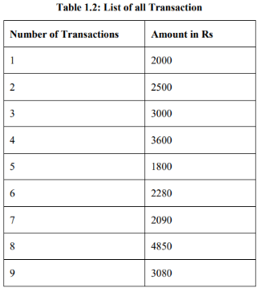
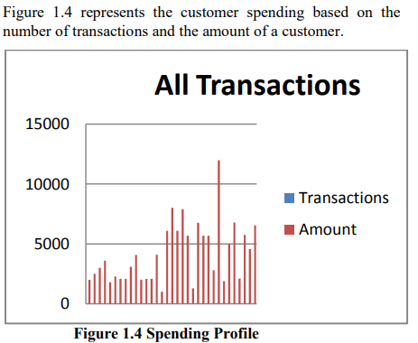
04
Literature Review
Fraud Detection by Monitoring Customer Behavior and Activities statements:
Singh et al proposed methodology to identify customer behavior in terms of spending and location. The study uses the KMEAN clustering algorithm to analyze customer spending behavior and identify unusual transactions. The study also looks at the geographical location of transactions to detect suspicious activity.
Their results are: 492 fraudulent in 284,807 transactions, representing 0.17% of the total transactions
Though their work is efficient but the data set is severely skewed, with fewer fraudulent transactions than real ones. This makes training and evaluating the model and detecting unusual and innovative fraud challenging. The model may not apply to other client categories or fraud trends.
Page 05

Slide 9
05
Critical Challenges
1
Data collection is difficult due to the involvement of sensitive customer data, making privacy and data security critical concerns.
2
Significant volume of data, making it time-consuming and challenging to identify the most important characteristics of the dataset
3
Fraudulent transactions are rare in comparison to genuine transactions, resulting in imbalanced datasets.
Page 06

Slide 10
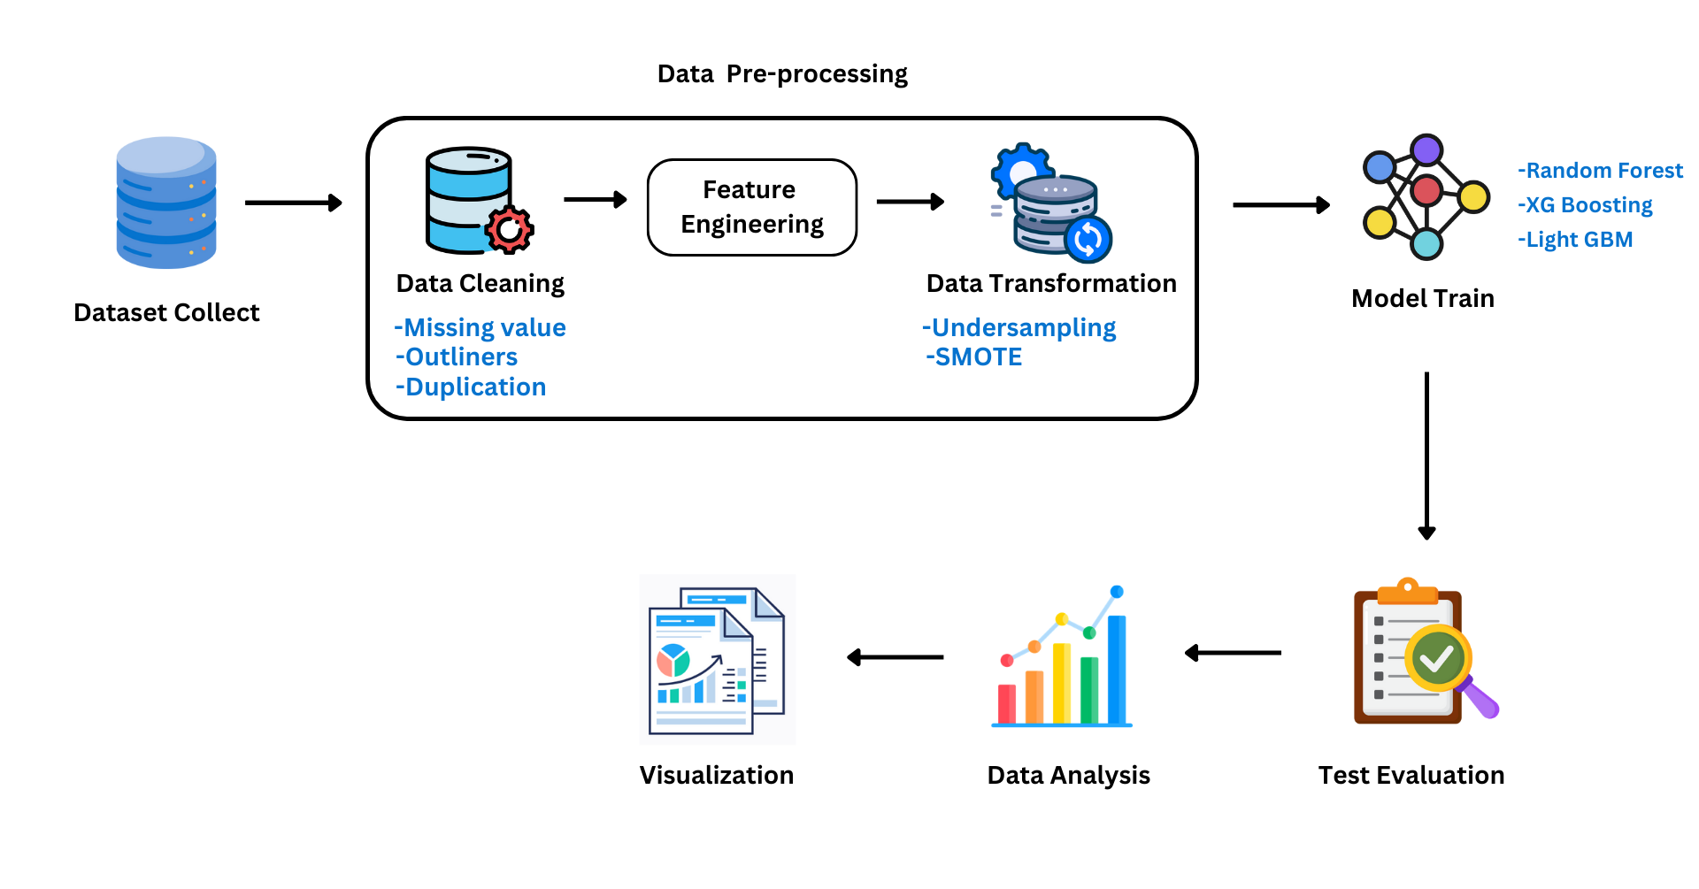
05
Methodology
Page 07

